Slide 1


INT254 Fundamentals of Machine Learning
Lecture #0
Agenda, Roadmap & Expectations

Slide 2

Course details
LTP – 2 0 2
Credits – 3.0
Mode – BYOD
Text Books:
1. NEURAL NETWORKS, FUZZY SYSTEMS AND EVOLUTIONARY ALGORITHMS : SYNTHESIS AND APPLICATIONS by RAJASEKARAN, S. PAI, G. A. VIJAYALAKSHMI, PHI Learning
References:
1. PRINCIPLES OF SOFT COMPUTING by PRINCIPLES OF SOFT COMPUTING, WILEY

Slide 3
Course Assessment Model
Marks break up*
Attendance 5
CA 25
Project (mandatory)
1 Best out of 2 Test
MTE (MCQ) 20
ETE (MCQ) 50
Total 100

Slide 4
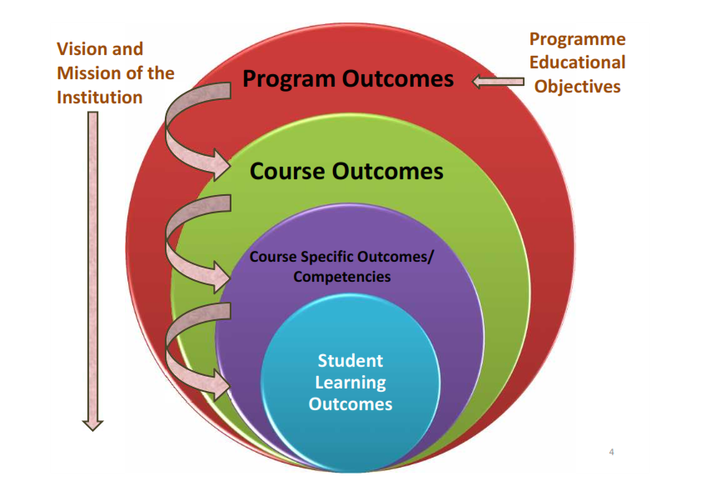
Program Outcomes
PO-1 Engineering knowledge::Apply the knowledge of mathematics, science, engineering fundamentals, and an engineering specialization to the solution of complex engineering problems.
PO-2 Problem analysis::Identify, formulate, research literature, and analyze complex engineering problems reaching substantiated conclusions using first principles of mathematics, natural sciences, and engineering sciences.

Slide 5
Program outcomes
PO-3 Design/development of solutions::Design solutions for complex engineering problems and design system components or processes that meet the specified needs with appropriate consideration for the public health and safety, and the cultural, societal, and environmental considerations.
PO-6 The engineer and society::Apply reasoning informed by the contextual knowledge to assess societal, health, safety, legal and cultural issues and the consequent responsibilities relevant to the professional engineering practice.
PO-12 Life-long learning::Recognize the need for, and have the preparation and ability to engage in independent and life-long learning in the broadest context of technological change.
PO-13 Competitive Skills::Ability to compete in national and international technical events and building the competitive spirit
5

Slide 6
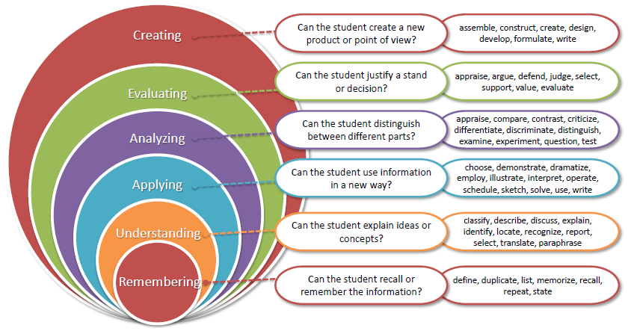
Revised Bloom’s taxonomy (RBT)
6

Slide 7
What are Cohorts
A group of students of a common programme who intend to attain similar characteristics by means of learning similar skills in order to target a particular career opportunity.

Slide 8
Purpose of Cohorts
Student shall be able to have a goal oriented approach for his/her career
Student identifies the goal in the very first year
Student shall be able to follow the stage wise career progression.
Early identification of skill set required for selected goal.

Slide 9
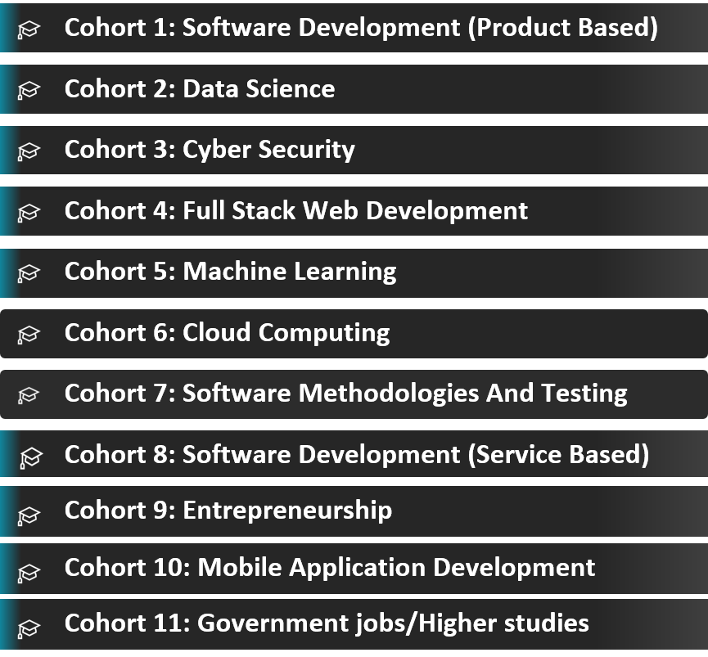
Cohort 8 and 5

Slide 10
Star Course
Hands-on Practice: A good course which include interactive coding exercises to help you apply what you've learned.
This course is a short bite-sized courses that help students develop foundational-level knowledge and skills in Python language. Although the course is packed with high quality content that helps students further with their learning and earn credits.

Slide 11
Course Outcomes
CO1 :: define the concepts of linear algebra and multivariate calculus
CO2 :: demonstrate the usage of various python libraries for data handling and visualization
CO3 :: explain the concepts of dimensionality reduction using PCA
CO4 :: make use of fuzzy logic to handle uncertainity in data
CO5 :: solve the optimization problems using genetic algorithms
CO6 :: examine various swarm optimization techniques to solve optimization problems

Slide 12
CO-PO Mapping
Outcomes | CO1 | CO2 | CO3 | CO4 | CO5 | CO6
PO1 | Yes |  |  | Yes | Yes | Yes
PO2 |  | Yes |  |  | Yes | Yes
PO3 |  | Yes | Yes | Yes
PO4 |  |  | Yes | Yes | Yes | Yes
PO5 |  |  | Yes | Yes | Yes | Yes
PO6
PO7
PO8
PO9 |  |  | Yes | Yes | Yes | Yes
PO10
PO11
PO12 | Yes | Yes | Yes | Yes | Yes | Yes
PO13 | Yes | Yes | Yes | Yes | Yes | Yes
PSO1 |  |  | Yes
PSO2 |  | Yes |  | Yes | Yes | Yes
PSO3 |  |  |  | Yes | Yes | Yes
PSO4 |  |  |  | Yes | Yes | Yes

Slide 13
OPEN EDUCATIONAL RESOURCE
Unit mapped | Broad topic/Sub Topic | OER Type | Title of OER | *%age unit mapped with OER (approx) | Source URL
Unit 1 | Linear Algebra and Multivariate Calculus | Reading Material | Linear Algebra and Multivariab le calculus | 100% 60% | https://www.britannica .com/biography/James- H-Wilkinson https://www.whitman.e du/mathematics/multiv ariable/multivariable.p df
Unit 2 | Data Handling and Visualization using Python | Reading Material | Data Preprocessi ng and visualizatio n | 100% 100% | https://www.geeksforge eks.org/data- visualization-with- python/ https://www.geeksforge eks.org/working-with- missing-data-in- pandas/
Unit 3 | Dimensionality Reduction | Reading Material | Reduce the dimensions of data | 80% | https://www.geeksforge eks.org/dimensionality- reduction/

Slide 14
Unit mapped | Broad topic/Sub Topic | OER Type | Title of OER | *%age unit mapped with OER (approx) | Source URL
Unit 4 | Fuzzy Logic | Reading | Fuzzification and defuzzificat ion | 50% | https://www.geeksforgeeks.org/fuzzy-logic-introduction/
Unit 5 | Genetic Algorithms | Material Reading Material | Genetic Algorithm | 100% | https://www.geeksforge eks.org/genetic- algorithms/
Unit 6 | Swarm Optimization Techniques | Reading Material | Nature Inspired Algorithms | 70% 60% | https://www.intechope n.com/chapters/59929 https://arxiv.org/pdf/23 11.12830.pdf

Slide 15

Machine Learning

Slide 16



Learning – Aspect #1

Slide 17


Discrete/Labeled dataset
You used prior learnings of -
Shapes
Patterns
Categories
Weighed them to MOST nearing entity
And finally classified it into ANSWER!!!

Slide 18
What is Machine Learning
Machine learning, the application and science of algorithms that makes sense of data, using self learning Algorithms we can turn data into knowledge.
When most people hear “Machine Learning” they picture a robot depending on who you ask
i.e. Optical Character Recognition

Slide 19
Cont.
Machine Learning is the science of programming computers so they can learn from data.
For example, your spam filter is a Machine Learning program that can learn to flag spam/Ham.

Slide 20
Use of Machine Learning
First you would look at what spam typically looks like. You might notice that some words or phrases (such as “Lottery,” “credit card,” “free,”) tend to come up a lot in the subject. Perhaps you would also notice a few other patterns in the sender’s name and so on.
You would write a algorithm for each of the patterns, and your program would flag emails as spam if a number of these patterns are detected.

Slide 21
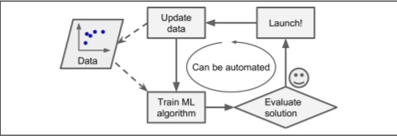
Cont.
Moreover, if spammers notice that all their emails containing “4U” are blocked, they might start writing “For U” instead. A spam filter using traditional programming techniques would need to be updated to flag “For U” emails.
Fig:- Automatically adapting to change

Slide 22
Types of Machine Learning
There are so many different types of Machine Learning systems that it is useful to classify them in broad categories based on:
Supervised Learning
Unsupervised Learning
Reinforcement Learning

Slide 23


Aspect #1 Challenge

Slide 24
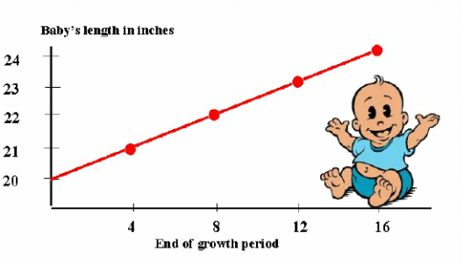
Learning – Aspect #2

Slide 25
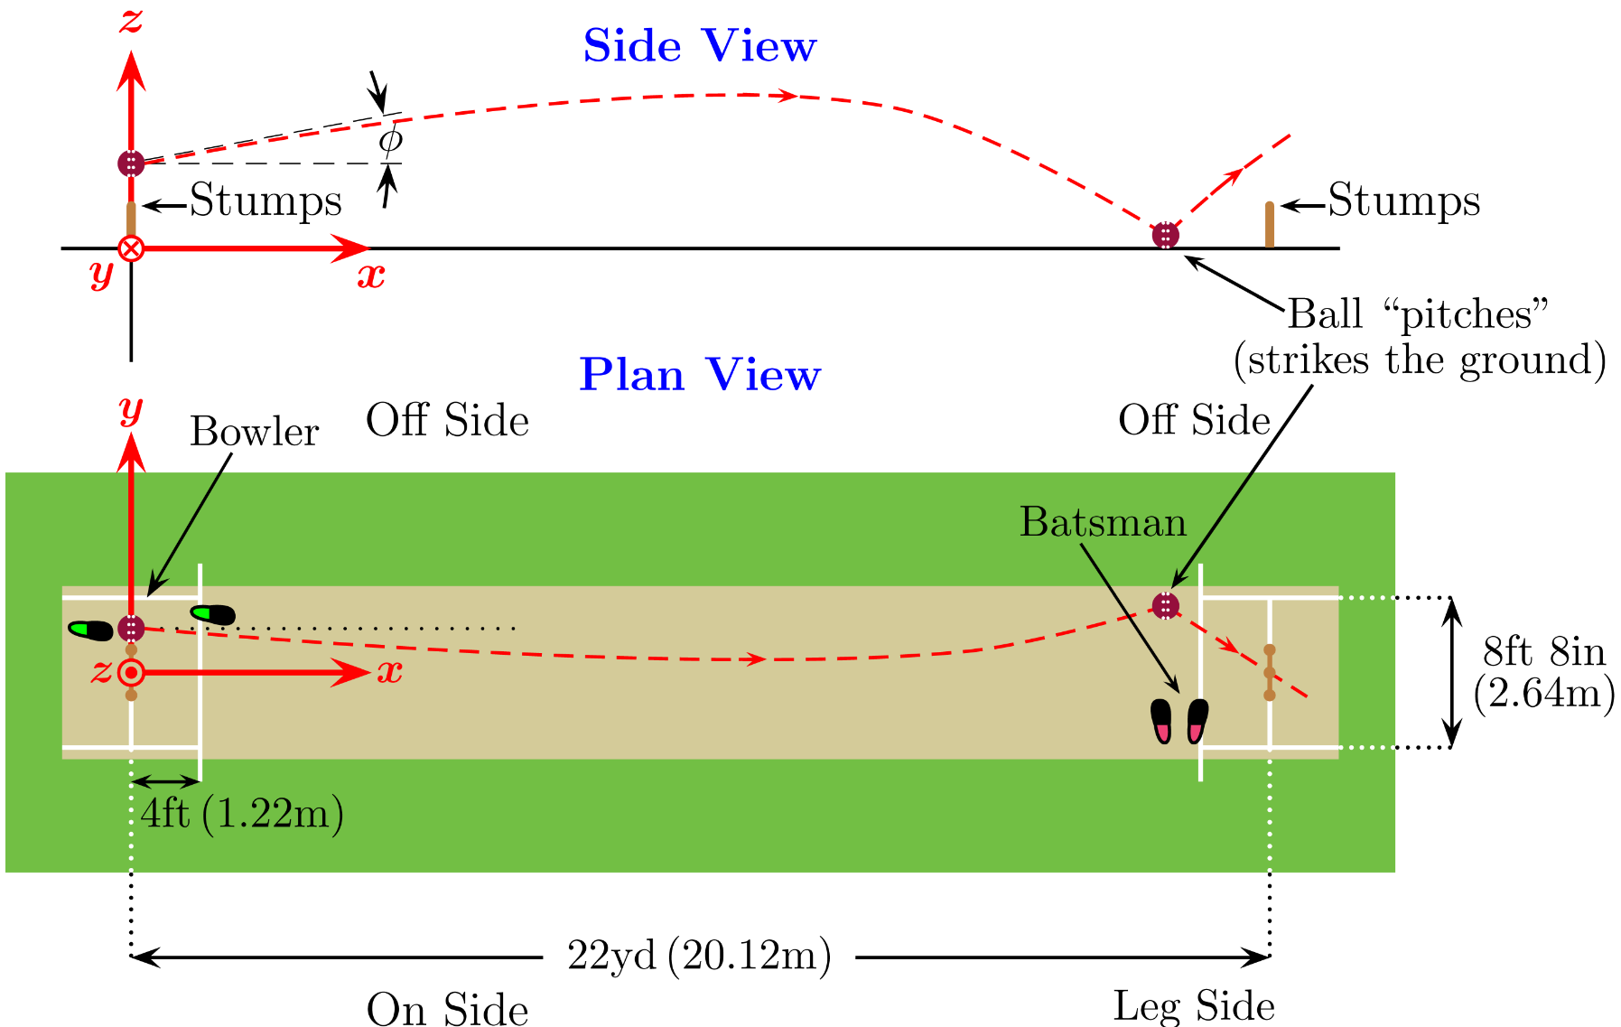
Learning – Aspect #2

Slide 26
Continuous dataset
You used prior learnings of -
Variability
Coordinate geometry
X – Y correlation
Plot reading
And finally build the ANSWER!!!

Slide 27
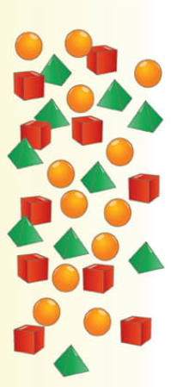
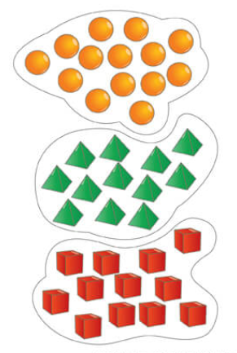
Learning – Aspect #3

Slide 28
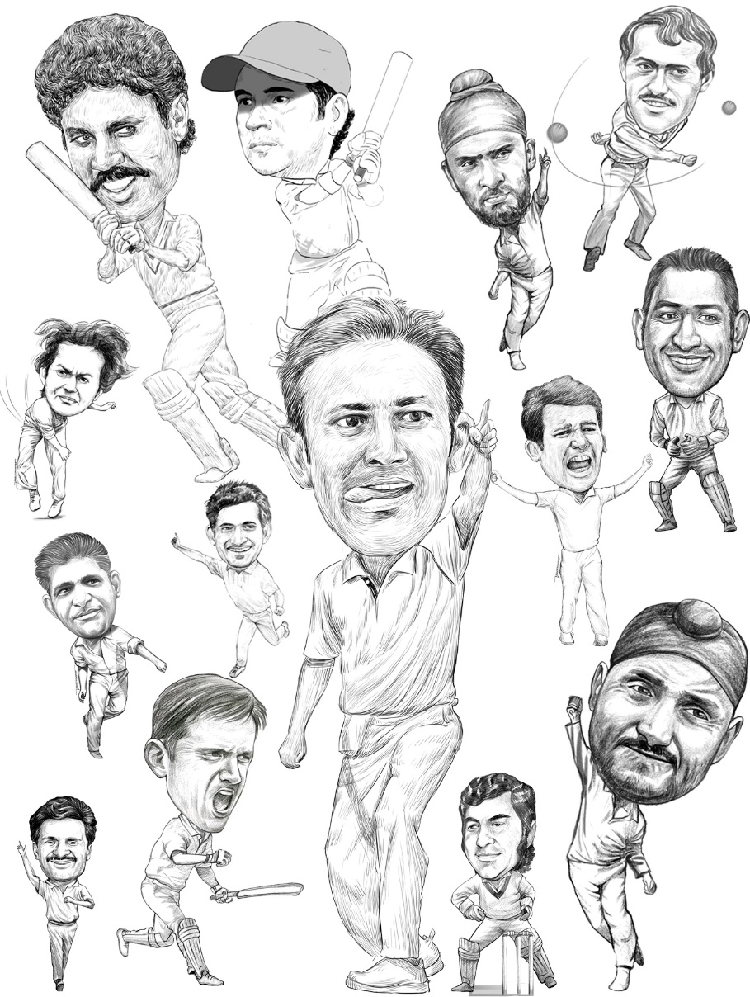
Learning – Aspect #3

Slide 29
Unknown dataset
You used prior learnings of -
Grouping objects
Extracting meaningfulness
Associating conjectures
And finally build the Clusters!!!

Slide 30
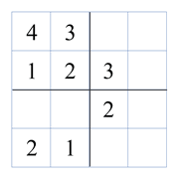
Learning – Aspect #4

Slide 31

Learning – Aspect #4

Slide 32
Iterative revisit
You played keeping
NEXT MOVE(s)
Probability of losing with a said move
Back tracking earlier opponent moves
And finally moved!!!

Slide 33
Aspect summary
#1 and #2
Prior information available to build answers
#3
Meaningful grouping of unknown and cluttered data
#4
Reiteration and loop back on pre and post information

Slide 34
Aspect summary
#1 and #2
Prior information available to build answers
#3
Meaningful grouping of unknown and cluttered data
#4
Reiteration and loop back on pre and post information
Supervised
Unsupervised
Reinforcement

Slide 35

Human v/s Computers
Everything is a PATTERN
Natural ability to learn, unlearn and relearn
Everything is DATA
Will need code to understand data, visualize data and extract meaning

Slide 36


Machine Learning

Slide 37
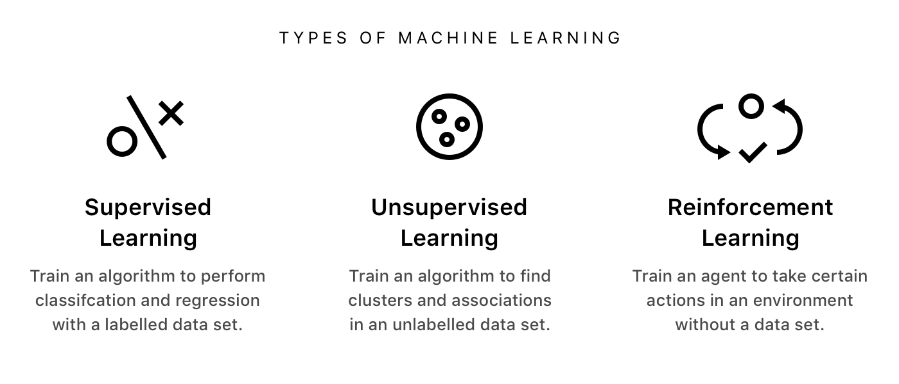

Slide 38
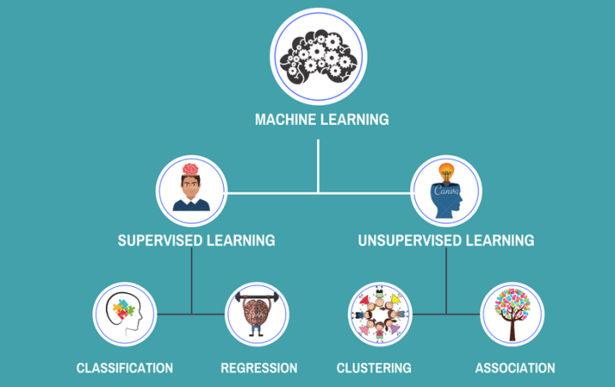

Slide 39
The course contents
Linear algebra : Introduction to linear algebra, operations with vectors, modulus and inner product, cosine and dot product, projection, changing basis, matrices, solving simultaneous equation problems, types of matrix transformation, determinants and inverses, matrices changing basis, orthogonal matrices, eigen values and eigen vectors
Multivariate calculus : Introduction to multivariate calculus, definition of a derivative, differentiation examples & special cases,, product rule, chain rule, differentiate with respect to anything, The Jacobian, The Hessian, multivariate chain rule, building approximate functions, power series, linearisation, multivariate taylor
Data handling and visualization using python : types of data, reading the data, math operations
for data analysis, handling missing values, Converting data into numerical format, correlation matrix, data visualization using different graphs
Dimensionality Reduction : statistics of dataset, orthogonal projections, problem setting and PCA objective, finding the coordinates of the projected data, steps of PCA, linear discriminant analysis, kernel PCA

Slide 40
The course contents
Fuzzy logic : basic definition and terminology, set-theoretic fuzzy operations, fuzzy sets and
operations on fuzzy sets, fuzzy relations, fuzzy rules and fuzzy reasoning, fuzzy inference system,
fuzzification and defuzzification methods, fuzzy based expert system
Genetic algorithms : introduction to genetic algorithms, genetic operators, working of genetic
algorithm, applications of genetic algorithm, genetic programming
Swarm optimization techniques : swarm intelligence, ant colony optimization, swarm intelligence in bees, cuckoo search, Firefly Algorithm, Crow Search Algorithm, Hybrid Wolf-Bat Algorithm, Whale Search Algorithm, grasshopper optimization

Slide 41
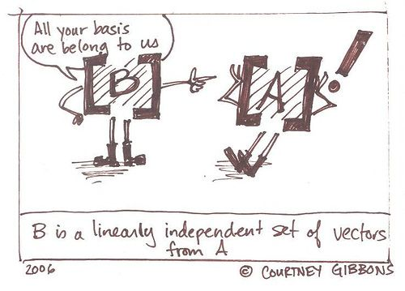
Linear Algebra

Slide 42
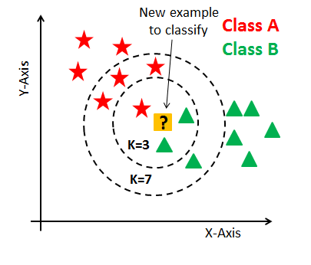

Data handling and visualization
Pandas,Numpy and Matplot Libraries

Slide 43
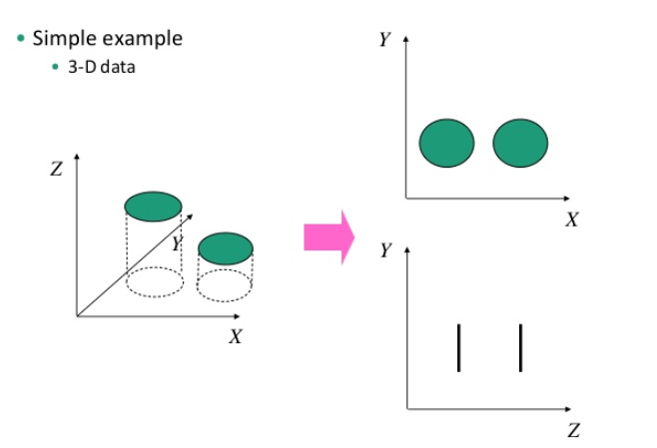
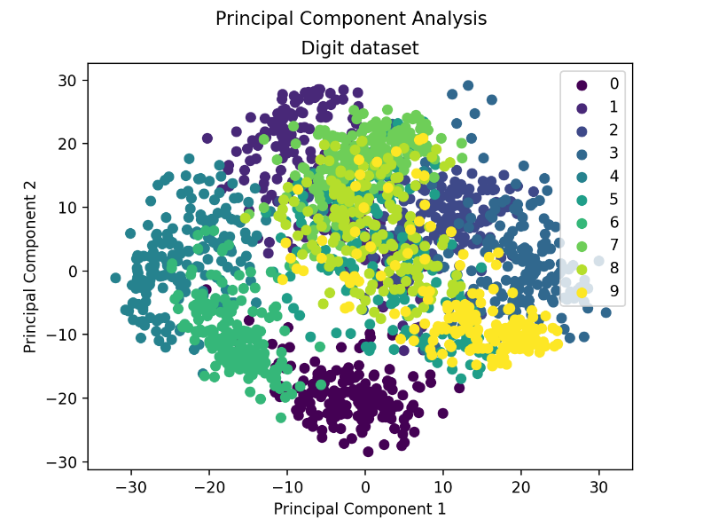
Dimension Reduction
Principle Component Analysis

Slide 44
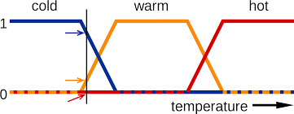
Fuzzy Logic

Slide 45
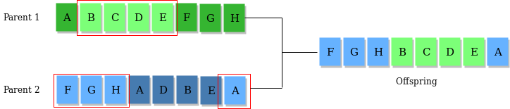
Genetic Algorithms

Slide 46
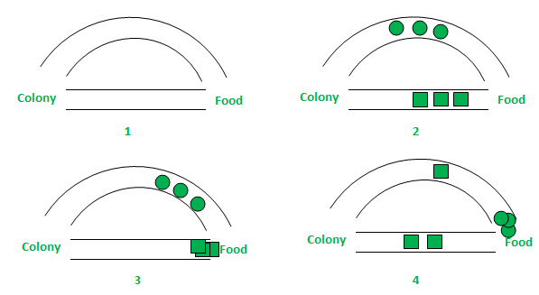
Swarm optimization Techniques

Slide 47

Get Set Go!!!
Get trained to TRAIN systems…
Build futuristic solutions…

Slide 48

Assessment expectations & example

